Slide 1
ECIR Model Enhancement for Jump Risk Management
Group 15

Slide 2
Jump Risks
Build upon traditional CIR model by including jump risks in its framework.
Assess and fine-tune the enhanced model. Then the prediction effect of CIR and ECIR on zero coupon bond price is measured and compared.
Finally we build the one day strategy.

Slide 3
Project Process
01
02
03
04
05
1981/9/1-
2024/4/15
1981/9/1-
2024/4/15
2023/12/15-
2024/4/15
2023/12/15-
2024/3/14
2024/3/15-
2024/4/15
Conclusion
Data
Preprocessing
Building ECIR
Monte-Carlo Simulation and Calibration
Performance Evaluation
Trading
Strategy

Slide 4

01
Data Preprocessing

Slide 5
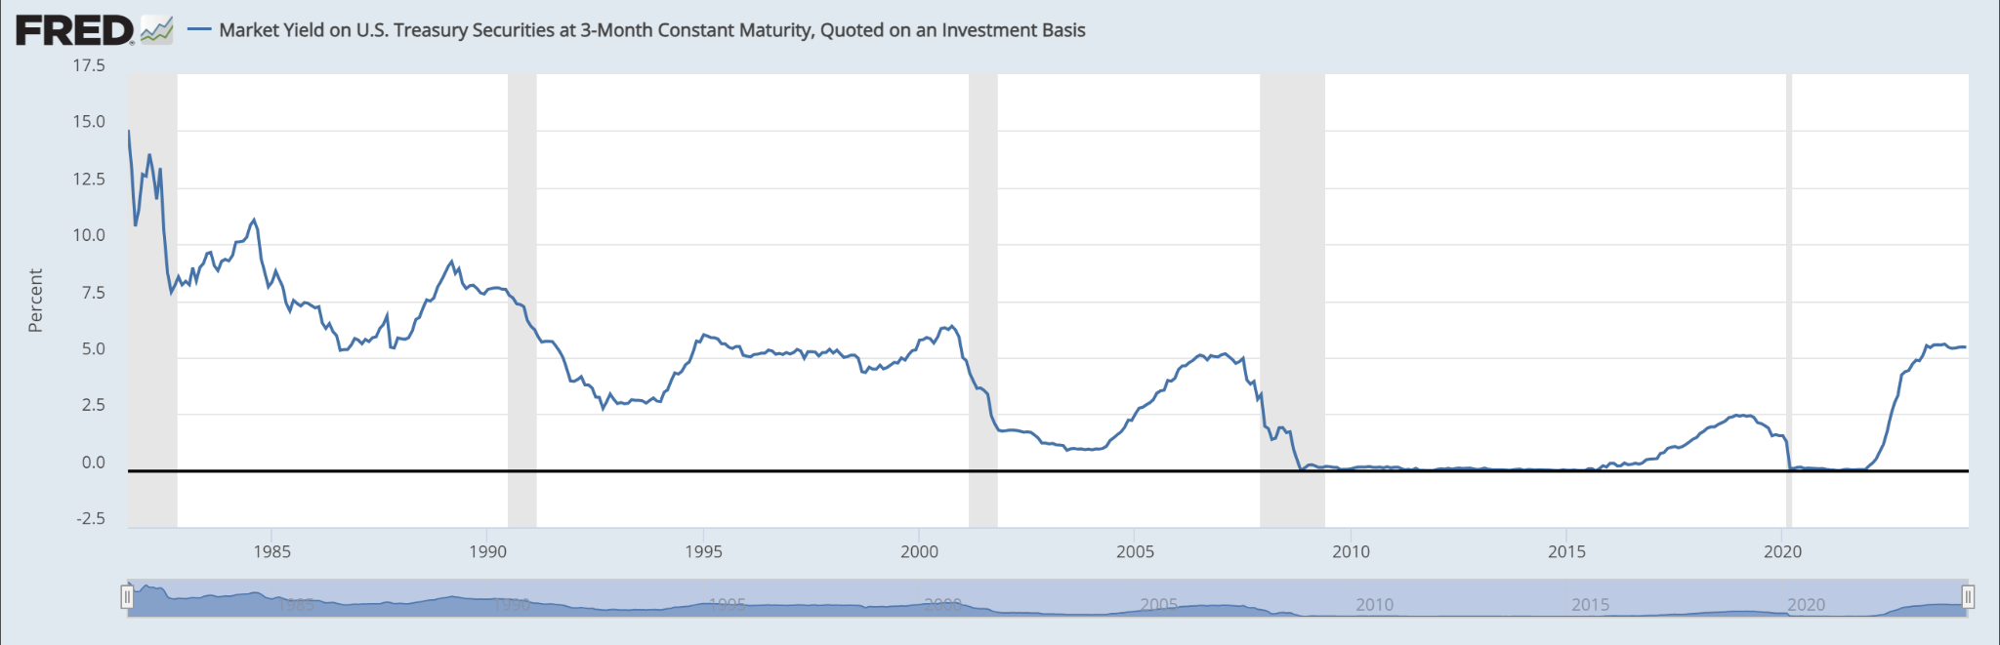
Data Sources & Yield Curve Analysis
US Treasury Zero-Coupon Yield Curve:
Additional Yield Measures:
30-year dataset sourced from FRED (Federal Reserve Economic Data)
Completed yield curve for discrete years via Cubic Spline interpolation
Yield to Maturity (YTM) for Treasury Bond Yields from FRED
Model parameters fitting using the Maximum Likelihood Estimation (MLE) approach (discussed later)

Slide 6

02
Extended CIR
Model

Slide 7
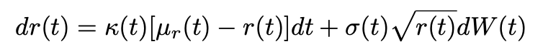
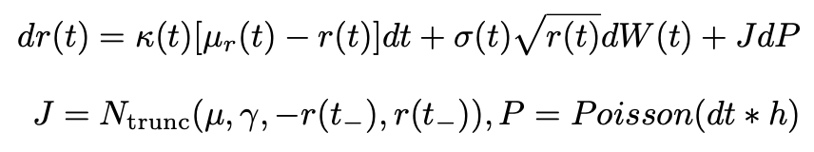
The CIR and Extended CIR Model
CIR:
Extended CIR
The extension of the standard CIR model allows us to introduce a jump component. −r(t−) < J < r(t−). This ensures the rate 𝑟(𝑡) = 𝑟(𝑡−)+𝐽 remains non-negative.

Slide 8

03
Simulation
& Calibration

Slide 9
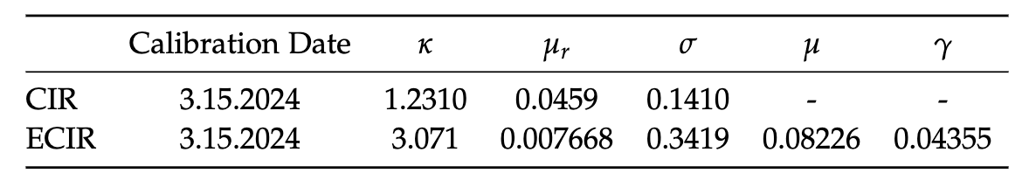
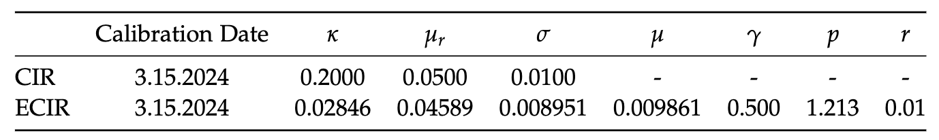
Calibration
Maximum Likelihood Estimation Approach
30-years Treasury Bonds
The yield curve snapshot from 2024-03-15 as described in the data section.
Assuming there are 252 trading days per year, dt = 1/252
Data: 3 month treasury bill YTM for the past 6 months from 2023-12-15 to 2024-03-15
Assuming there are 252 trading days per year, dt = 1/252
Yield Curve Fitting Approach
Calibrated Model Parameters
for Yield Curve Fitting Approach
Calibrated Model Parameters
for MLE Approach

Slide 10

04
Evaluation

Slide 11
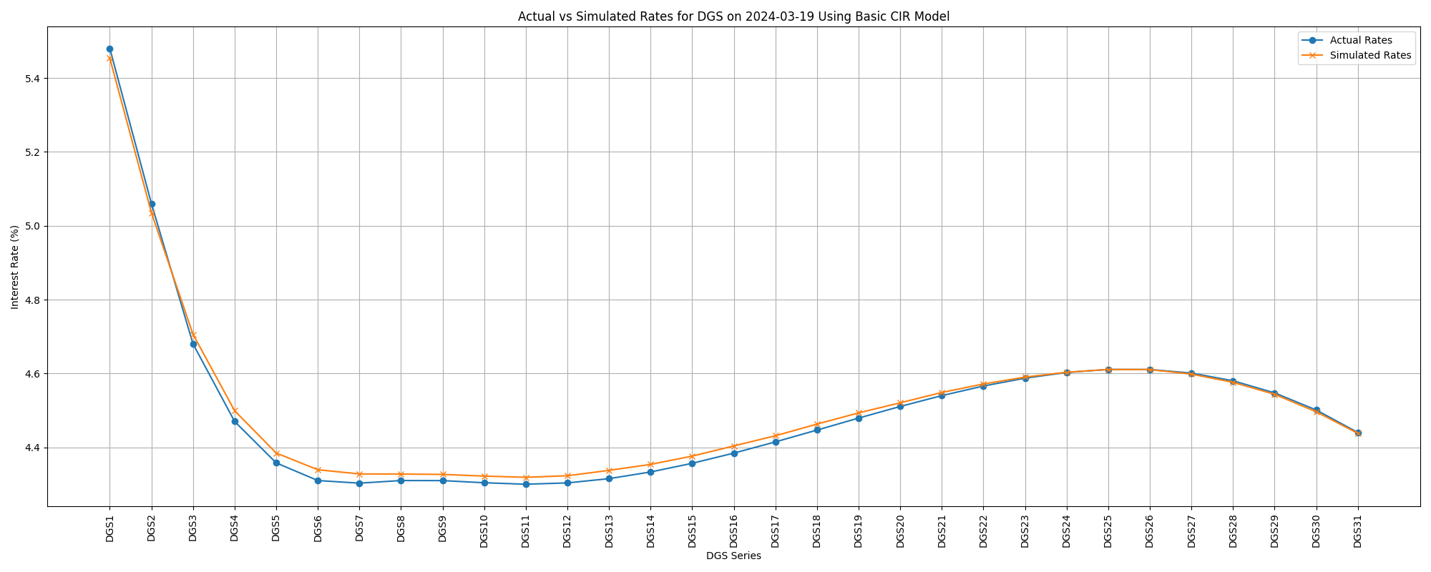
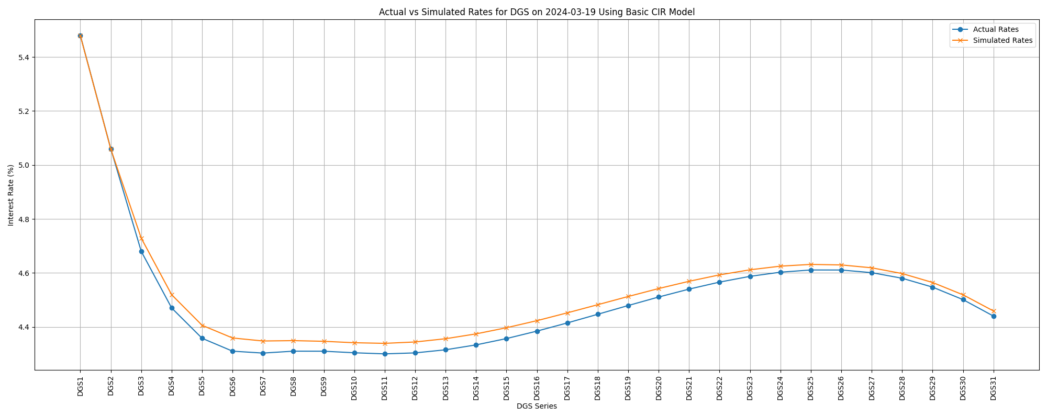
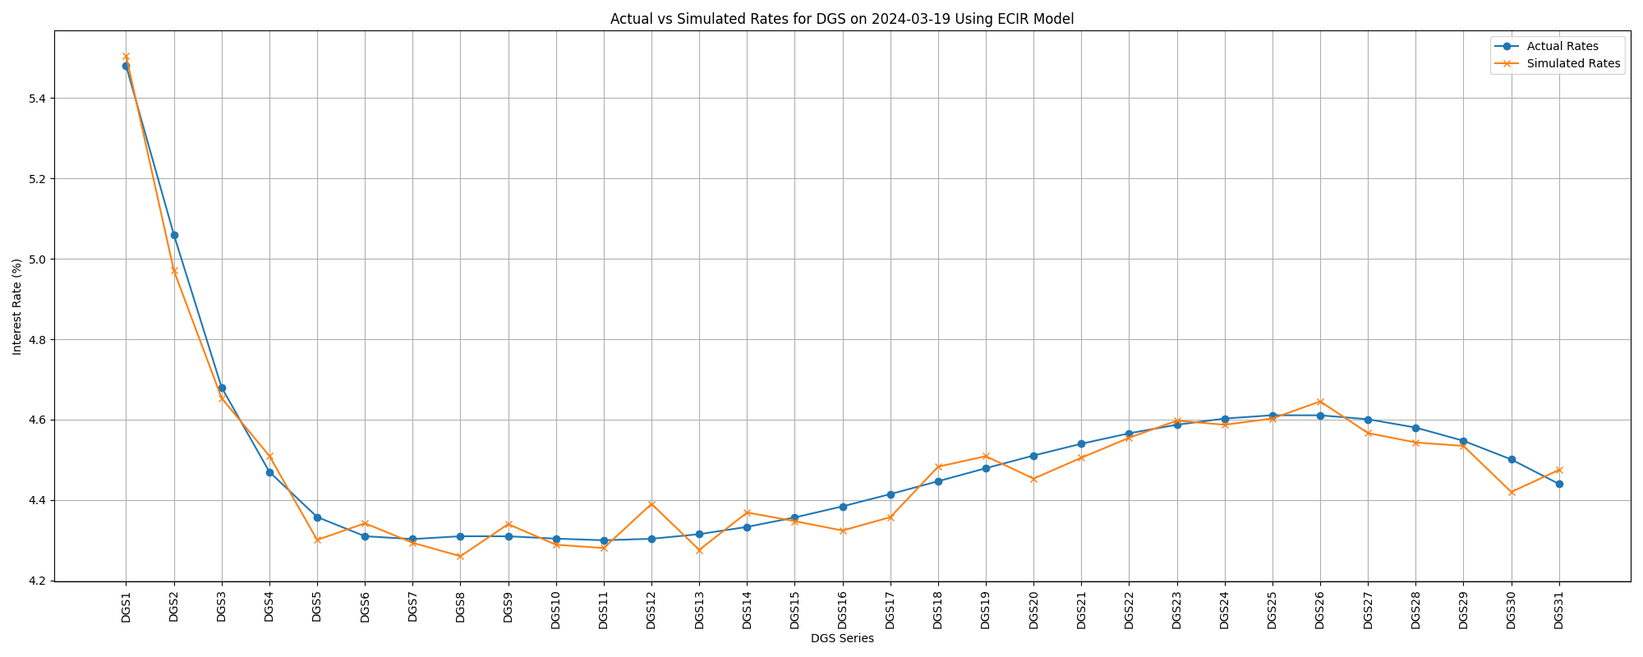
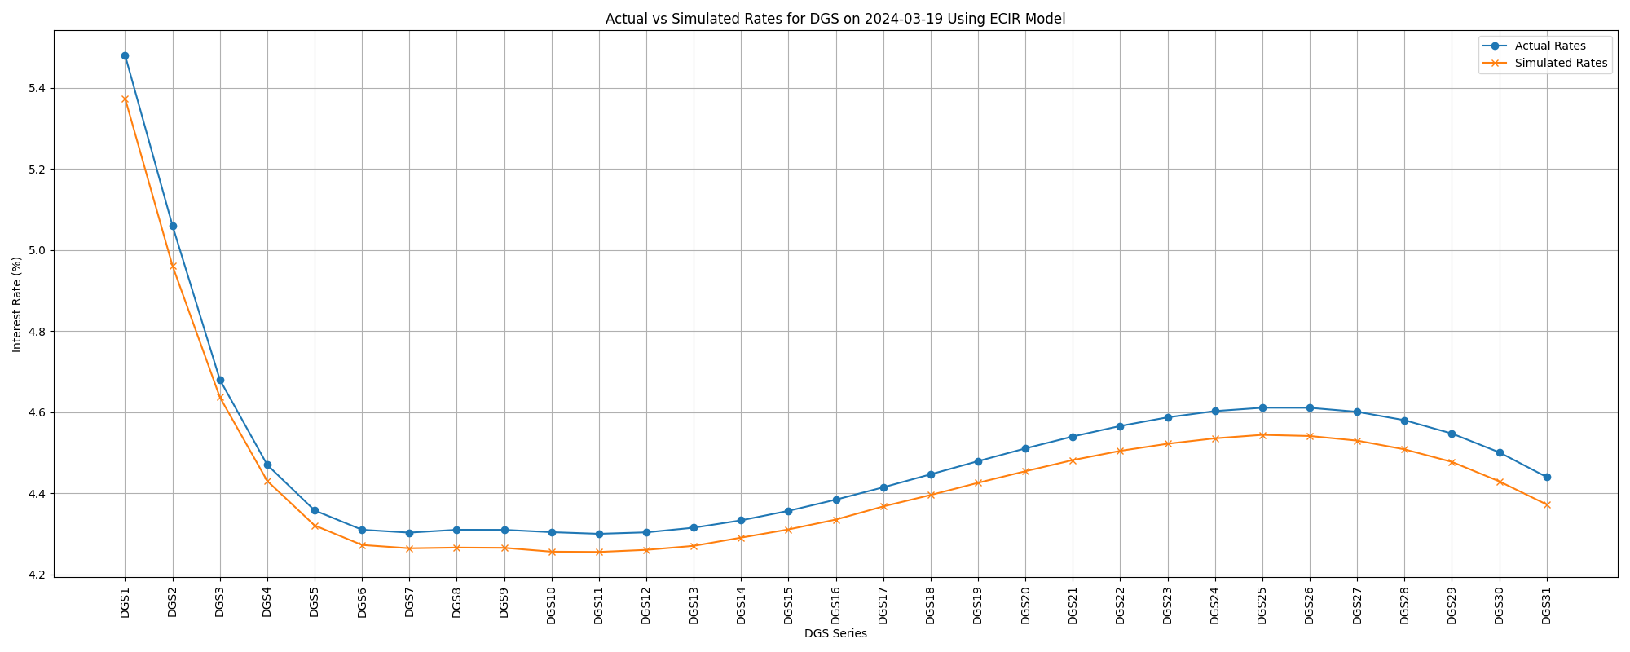
Yield Curve Fitting
Yield Rate
MLE
CIR
ECIR

Slide 12
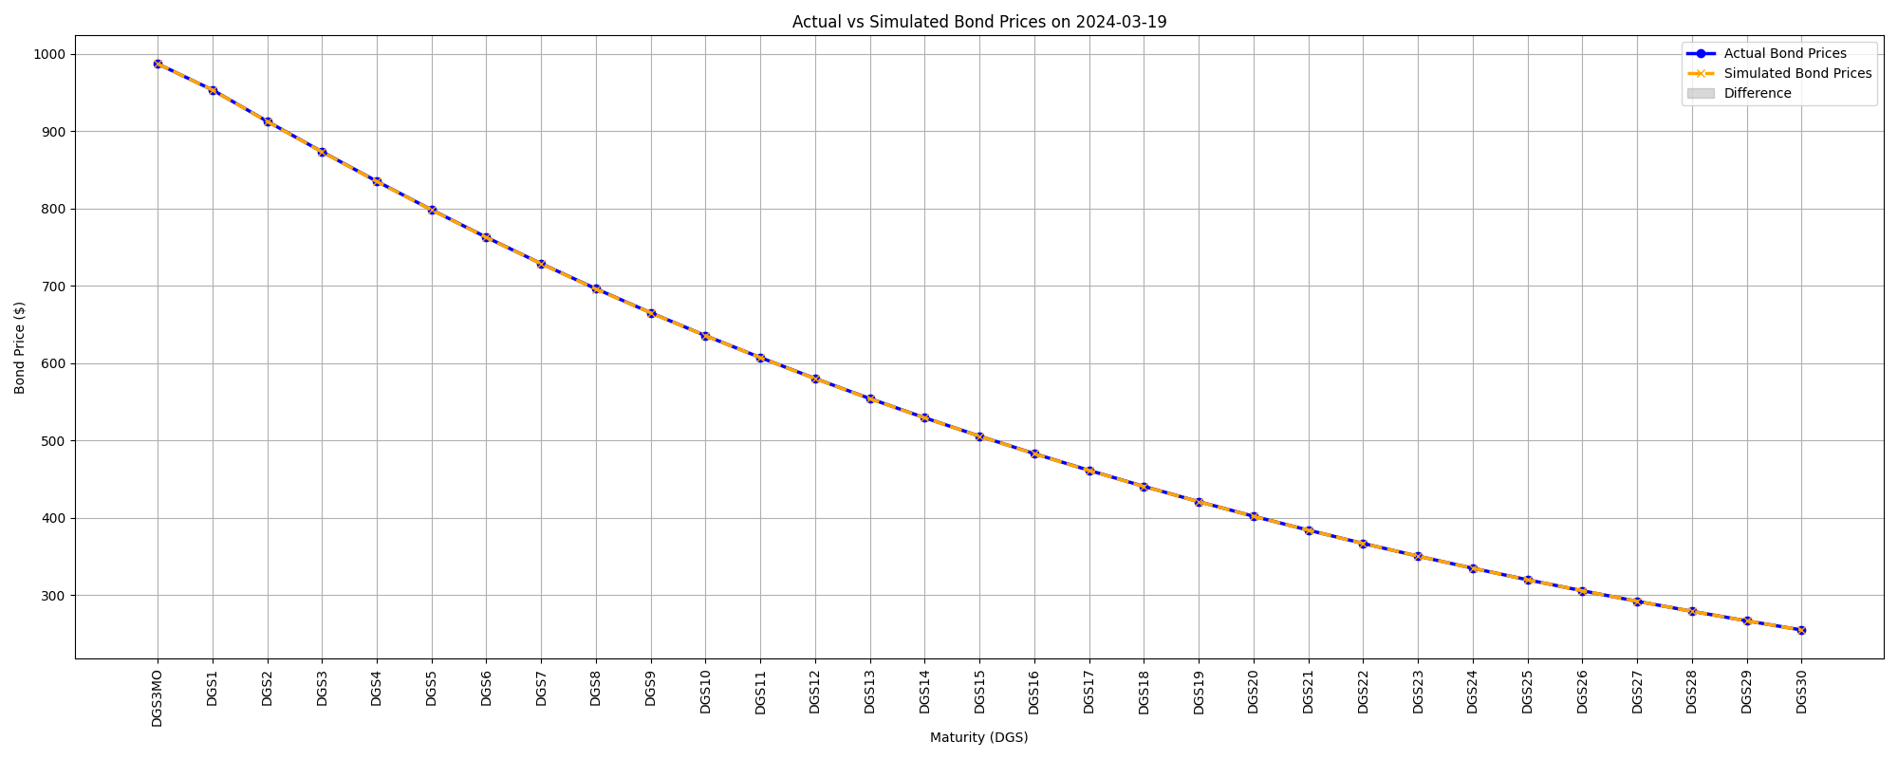
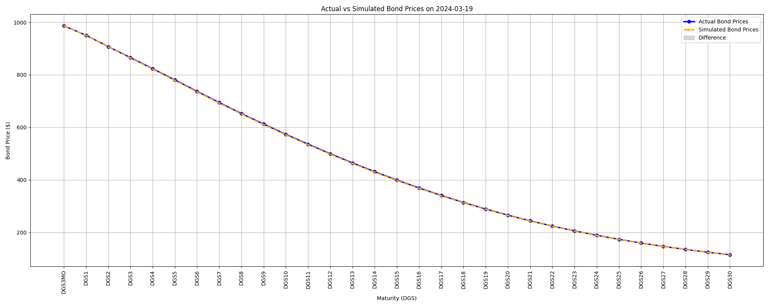
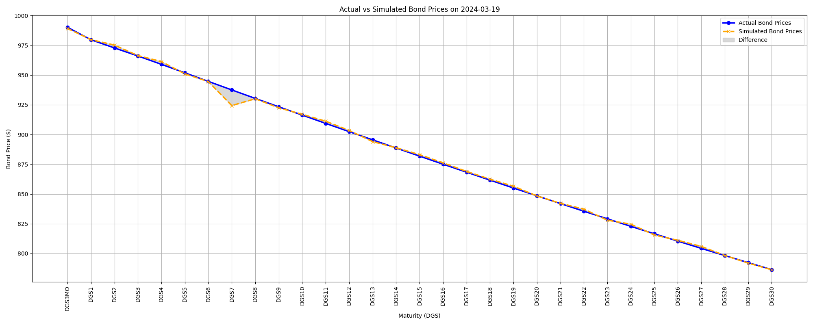
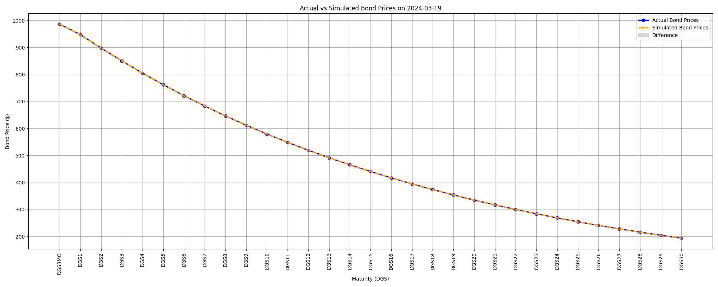
Yield Curve Fitting
Bond Price
MLE
CIR
ECIR

Slide 13
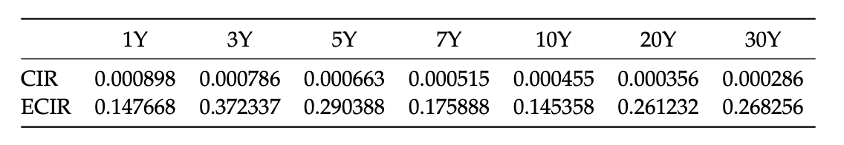
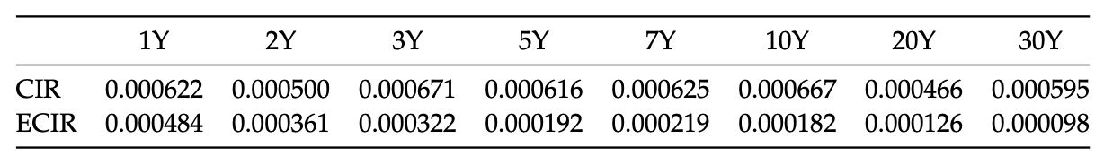
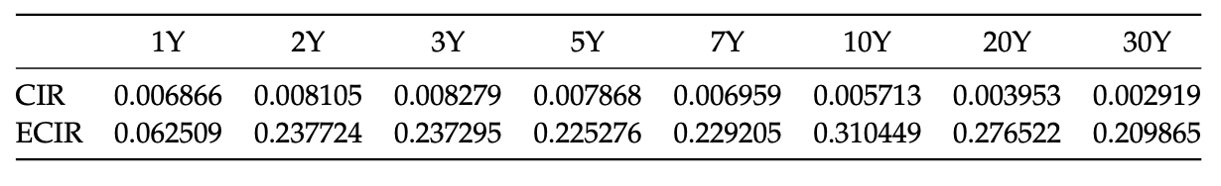
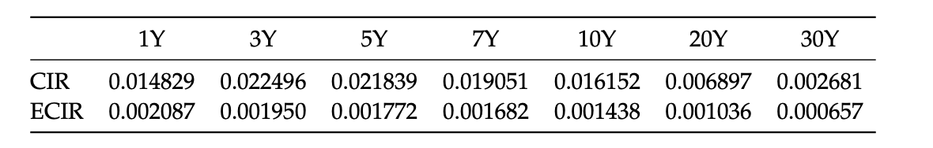
Yield Curve Fitting
Standard Deviation
MLE
Yield Rates
Bonds
Price

Slide 14
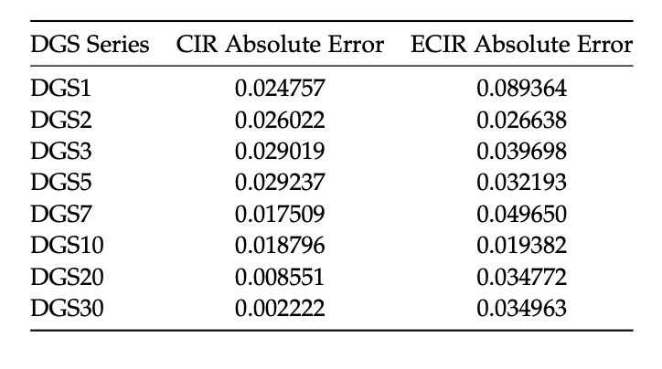
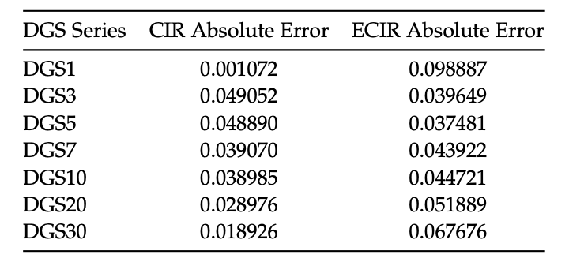
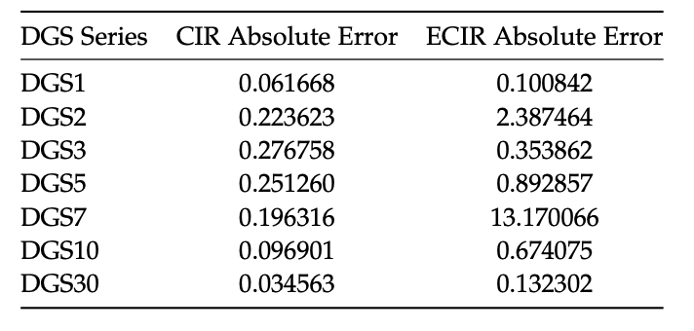
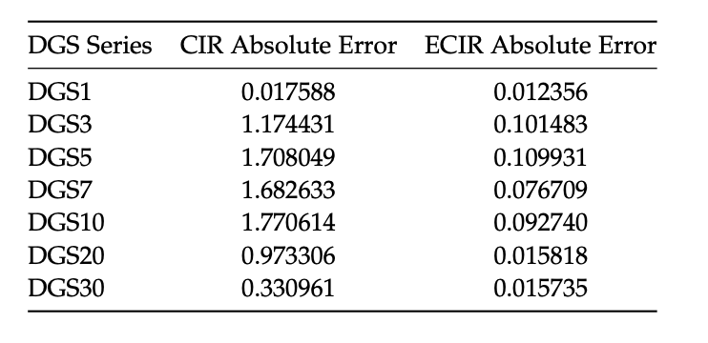
Yield Curve Fitting
Absolute Errors
MLE
Yield Rates
Bonds
Price

Slide 15
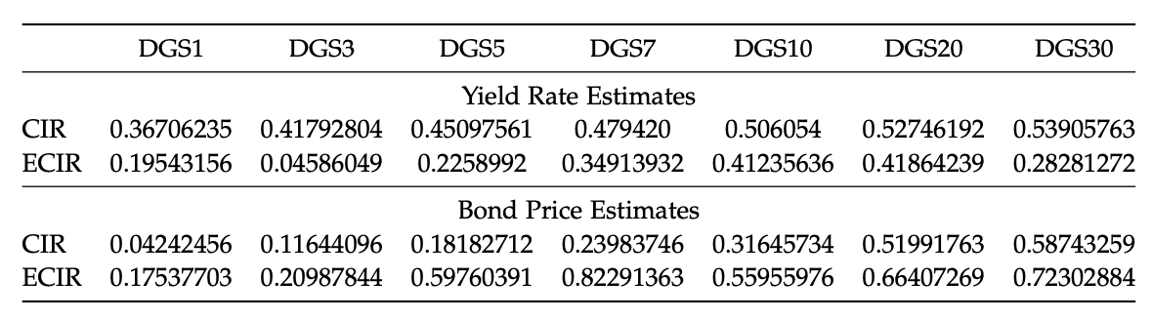
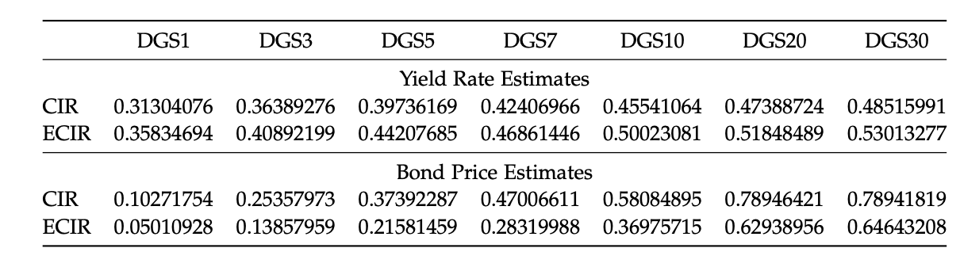
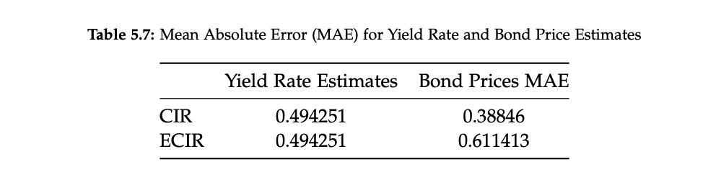
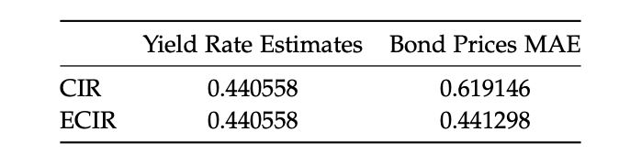
Yield Curve Fitting
Mean Absolute Errors
MLE

Slide 16
05
Trading Strategy

Slide 17
Methodology
Predict next day’s yield curve and bond prices
Next day: determine if actual prices are overvalued or undervalued
Take top 5 bonds with smallest prediction errors; short if overvalued, long if undervalued
Close position the following day
Repeat, re-investing all capital including any profit

Slide 18
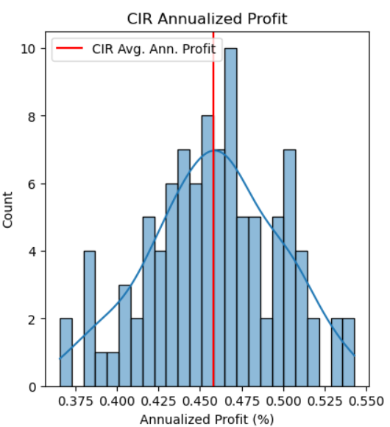
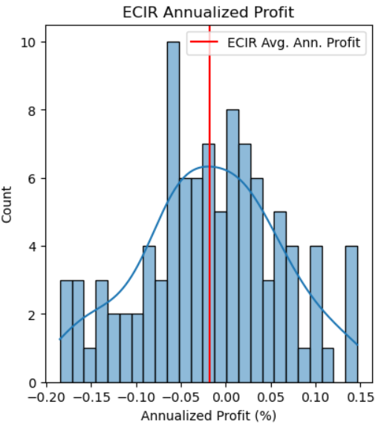
Results - Total Profit
Average Annualized Profit: -0.02%
Average Annualized Profit: 0.46%

Slide 19
Results - Individual Bonds
*Results are averaged annualized profit, expressed as a percentage

Slide 20
Conclusion
Calibration Method Flexibility
Perform differently depending on the calibration method.
Yield Curve Fitting Approach
Offers better precision for short- to mid-term bond maturities.
Adaptability
The ECIR model's adaptability to different calibration approaches makes it versatile for a range of predictive scenarios.
MLE Method
Demonstrate lower variability in predictions.
Deliver more consistent and accurate results across all maturities.
Error Rate
Provide more precise predictions for specific bond maturities when assessed by absolute errors and MAE.

Slide 21
Thank you

